Slide 1
Risk Management Overview

Slide 2
Risk Management Overview
Agenda
What is Risk?
What is Risk Management?
The Crowe Framework
Organisational Perspectives
Principals
Approach
Process
Embedding & Reviewing
Risk Documents
Common Techniques
Health Check & Maturity Model

Slide 3
Risk Management Overview
What is Risk?
Risk is defined as……
“An uncertain event or set of events that, should it occur, will have an effect on the achievement of objectives. A risk is measured by the combination of the probability of a perceived threat or opportunity occurring and the magnitude of its impact on objectives”

Slide 4
Risk Management Overview
What is Risk Management?
The systematic application of principals, an approach, and a process applied to the tasks of identifying and assessing risks, and the subsequent planning and implementation of risk responses. This provides a disciplined environment for proactive decision-making.
For Risk Management to be effective, risks need to be:
Identified
Assessed
Controlled

Slide 5
Risk Management Overview
What is Risk Management?
For Risk Management to be effective, risks need to be:
Identified: Considering uncertainties that would affect the achievement of objectives within the context of a particular organisational activity, and then describing/communicating them in order to ensure a common understanding
Assessed: Estimating the probability, impact and proximity of individual risks so they can be prioritised. Understanding the overall level of risk (risk exposure) associated with the organisational activity
Controlled: Planning appropriate responses to risks, assigning owners and actionees. Implementing, monitoring and controlling these responses

Slide 6
Risk Management Overview
The Crowe Framework
Based on four core concepts:
Principals
Approach
Process
Embedding and Reviewing

Slide 7
Risk Management Overview
The Crowe Framework

Slide 8
Risk Management Overview
Organisational Perspectives
Applying Principals, Approach and Process according to Organisational perspective:
Strategic
Programme
Project
Operational

Slide 9
Risk Management Overview
Organisational Perspectives
Strategic
Concerned with ensuring overall business success, vitality and viability
Sets the scene for the management of risk across the entire organisation
Information flows should be established between those with strategic responsibility and those with operational and programme responsibility
Establish information flows with those with project responsibilities if project outputs are of strategic importance.

Slide 10
Risk Management Overview
Organisational Perspectives
Programme
Concerned with transforming business strategy into new ways of working that deliver measurable benefits to the organisation viability
Sets the scene for the management of risk within the programme, and the projects and operational activities that form part of the programme
Information flows should be established between those with programme responsibility and those with project responsibilities within the programme
Establish information flows with those with operational responsibilities if the programme has an impact on these or vice-versa

Slide 11
Risk Management Overview
Organisational Perspectives
Project
Concerned with delivering defined outputs to an appropriate level of quality within agreed scope, time and cost constraints
Sets the scene for the management of risk within the project
Information flows should be established as required if the project supports strategic, programme or operational objectives

Slide 12
Risk Management Overview
Organisational Perspectives
Operational
Concerned with maintaining appropriate levels of business services to existing and new customers
Sets the scene for the management of risk within particular operational (service delivery) areas
Information flows need to be established between those with operational responsibilities, and those with strategic, programme and project responsibilities where any or all of these will have an impact on the operational area or vice-versa

Slide 13
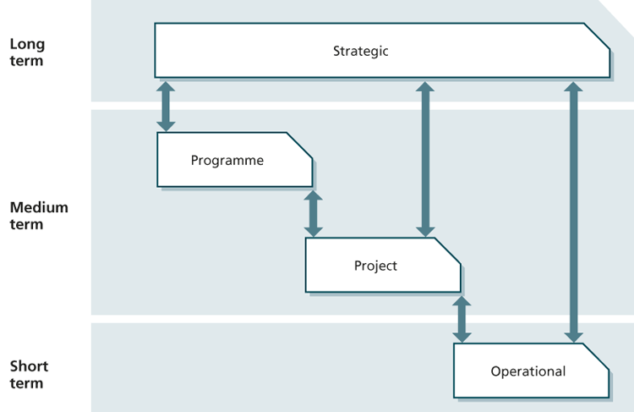
Risk Management Overview
Organisational Perspectives

Slide 14
Risk Management Overview
Management of Risk Principals
Effective Risk Management satisfies the following eight principals:
Aligns with objectives
Fits the context
Engages stakeholders
Provides clear guidance
Informs decision-making
Facilitates continual improvement
Creates a supportive culture
Achieves measurable value

Slide 15
Risk Management Overview
Management of Risk Principals
Aligns with Objectives:
Consider the objectives from each of the four organisation perspectives
Determine Risk Capacity & Risk Appetite for each of the four organisational perspective
Remember that objectives can change, as such Risk Management is dynamic not static and is therefore a repetitive process

Slide 16
Risk Management Overview
Management of Risk Principals
Fits the Context:
External
Sector, Markets, Locations, Technologies, Regulatory Regimes
Internal
Culture, Organisational Structure, Stakeholder Relationships
Remember that context can change, as such Risk Management is dynamic not static and is therefore a repetitive process
Designing the Risk Management Approach such that it can be applied to different & changing context, dealing effectively with risks, while at the same time, avoiding wasted effort/money

Slide 17
Risk Management Overview
Management of Risk Principals
Engages Stakeholders:
Adopt an appropriate level and style of communication
Understand Stakeholder perception of risks
Establish a common language/terminology
Proactive and timely involvement
Stakeholder Analysis
Influence/Interest matrix
RACI diagram

Slide 18
Risk Management Overview
Management of Risk Principals
Provides Clear Guidance:
Establish clear practices
Apply practices coherently across all parts of the organisation
Ensure consistency of information flows across organisational perspectives

Slide 19
Risk Management Overview
Management of Risk Principals
Informs Decision Making:
Help decision-makers understand the relative merits, threats, and opportunities associated with alternative courses of action
Establish Roles & Responsibilities
Establish Reporting & Escalation arrangement
Define Risk Tolerance
Establish Key Performance Indicators (KPI’s)

Slide 20
Risk Management Overview
Management of Risk Principals
Facilitates Continual Improvement:
Collecting actual performance data about how risks were identified, assessed and controlled, forms the basis for historical reference, allowing an organisation to learn from experience
Establish a thorough system of internal control
Risk Health Check
Risk Maturity Model

Slide 21
Risk Management Overview
Management of Risk Principals
Create a Supportive Culture:
Organisation must recognise that managing risk appropriately means taking calculated chances
Zero risk is neither possible nor desirable. A tolerable level of risk that matches the appetite for the organisational activity is needed
Embedding of Risk Management into everyone’s day-to-day activities
Open and honest discussion without fear of retribution
Recognition and reward for managing risk proactively

Slide 22
Risk Management Overview
Management of Risk Principals
Achieves Measurable Value:
Establish baselines and processes to measure and track performance over time
Examples
Reduces waste and re-work
Increases customer/client/user confidence
Improves regulatory performance
Improves levels of Health & Safety

Slide 23
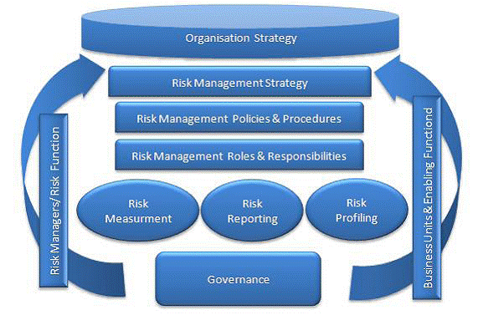
Risk Management Overview
Management of Risk Approach
The way in which Risk Principals are implemented
Centred around a set of key documents

Slide 24
Risk Management Overview
Management of Risk Approach
Key documents
Risk Management Policy
Risk Management Process Guide
Risk Strategy
Risk Register
Issue Register
Risk Improvement Plan
Risk Communications Plan
Risk Response Plan
Risk Progress Report

Slide 25
Risk Management Overview
Management of Risk Approach
Risk Management Policy
States why and how Risk Management will be implemented throughout an organisation
Communicates in a common language
Strives to establish uniformity across the Risk Management process and remove ambiguity about the organisation’s overall risk capacity, appetite and tolerance levels
Describes the format and timing of reporting
Subject to review on an annual basis and/or as a reaction to new legislation or government guidance

Slide 26
Risk Management Overview
Management of Risk Approach
Risk Management Process Guide
Describes how the process steps (from Identify through to Implement) will be carried out in the organisation
Designed for all types of activity across the organisation
Compliance with the Process Guide is often one of the hurdles used to establish a satisfactory level of internal control
Subject to review on an annual basis and/or as a reaction to new legislation or government guidance

Slide 27
Risk Management Overview
Management of Risk Approach
Risk Management Strategy
Describes the specific Risk Management activities that will be taken for a particular organisational activity
Multiple strategies are commonly used across an organisation, reflecting the need to apply risk differently according to the activity being considered, while still reflecting the overall organisational Policy and Process Guide
Outlines the Risk Appetite for an organisational activity
Where appropriate, may relate to the OGC Gateway Review process for the public sector or alternative assurance and approval processes for the private sector

Slide 28
Risk Management Overview
Management of Risk Approach
Risk Register
Purpose is to capture and maintain information on all of the identified threats and opportunities relating to a specific organisational activity
Provides a snapshot, at any point in time, of the identified risks for the organisational activity in question, the priority of each risk, the risk owner for each risk, and the response strategy chosen by each risk owner
Should also record when each risk was closed and why
Document should be subject to formal document and version control

Slide 29
Risk Management Overview
Management of Risk Approach
Issue Register
Purpose is to capture and maintain information on all of the identified issues that are happening now and require action
Issues may have arisen from risks that had been identified, but not managed
Issues that have been raised, may be causes of new risks
Important to understand issues, and how they are related to, yet different from, risks
Timely transfer of relevant information between the Risk Register and the Issue Register enhances the effectiveness of management processes

Slide 30
Risk Management Overview
Management of Risk Approach
Risk Improvement Plan
Purpose is to assist with embedding Risk Management into the culture of the organisation and to document planned improvements
Provides a record of the current maturity level of Risk Management within the organisation, the targets that have been set, the time period within which each target should be achieved, and the planned mechanisms/method that will be used to achieve the desired results
Describes what the organisation needs to do to deal with the common process barriers

Slide 31
Risk Management Overview
Management of Risk Approach
Risk Communications Plan
Describes how information will be distributed to, and received from, all relevant stakeholders of a particular organisational activity.
May form part of a wider communication plan within the organisation
Effective communication between stakeholders is a critical success factor for Risk Management, ensuring that risks are identified and assessed, and that suitable responses are planned and owned

Slide 32
Risk Management Overview
Management of Risk Approach
Risk Response Plan
Details specific plans for responding to a single risk or a linked set of risks
Linked to the ‘risk response’ field of the Risk Register
Useful where a particular risk (or linked set of risks) warrants a significant and resource-intensive response
Important to maintain the link with the Risk Register as progress is made in order to preserve data integrity and clarity of current status

Slide 33
Risk Management Overview
Management of Risk Approach
Risk Progress Report
Provides regular progress information to management on risk management within a particular organisational activity
Comments on the progress of planned actions and their effectiveness
Reports trend analysis and reports performance against measures established to demonstrate the value of risk management activities

Slide 34
Risk Management Overview
Management of Risk Approach
Relationship between Documents
At an organisational level, a Risk Management Policy, a Risk Management Process Guide, and at least one Risk Management Strategy must exist
Multiple Risk Registers and Issue Registers will exist with an organisation, and a way of ensuring that risks and issues are handled within the correct perspective is essential
The Risk Improvement Plan has close links with the approach (Policy, Process Guide & Strategy) for the organisational activity in question and the organisation as a whole. Improvements must be co-ordinated across the organisation, with clear reporting of plans and progress, via the Risk Progress Report

Slide 35
Risk Management Overview
Management of Risk Approach
Relationship between Documents

Slide 36
Risk Management Overview
Management of Risk Process

Slide 37
Risk Management Overview
Management of Risk Process
Four primary steps
Identify
Assess
Plan
Implement
Carried-out in sequence
Repetitive in nature
Embed & Review embraces each step
Principals permeate each step

Slide 38
Risk Management Overview
Management of Risk Process
Common barriers to the implementation of process
Lack of organisational culture that appreciates the benefits of Risk Management
Immature Risk Management practices
Lack of resources and time
Lack of policies, strategies and plans
Lack of senior management sponsorship
Lack of training, knowledge and clear guidance
Lack of incentives for participation in Risk Management activities

Slide 39
Risk Management Overview
Management of Risk Process
Communication is vital across the whole process
Everyone must understand
How the organisation’s Risk Capacity and Risk Appetite is expressed by Risk Tolerances for the work in question
The Risk Policy, Risk Process and Risk Strategy relevant to their role
The benefits of effective Risk Management and the potential implications if it is not done

Slide 40
Risk Management Overview
Management of Risk Process
Communication is vital across the whole process
Each level of management must actively seek and receive assurances about the management of risk within their control
Procurement teams must ensure that risk ownership is clearly specified within contracts and service agreements
Transferrable lessons must be communicated to anyone that can benefit from them

Slide 41
Risk Management Overview
Management of Risk Process
Identify, Access, Plan and Implement process steps
Described in the following format
Goals
Inputs
Outputs
Techniques
Tasks

Slide 42
Risk Management Overview
Management of Risk Process
Identify can be split into two sub-processes
Identify – Context
Identify – Risks

Slide 43
Risk Management Overview
Management of Risk Process
Identify - Context
Goal is to obtain information about the planned activity and how it fits into the wider organisation. This will include understanding:
What constraints are relevant to the activity
Who the stakeholders are and what their objectives are
Where the activity fits in relation to the organisational structure
The organisation’s environment (industry, market, etc.)
The organisation’s approach to Risk Management

Slide 44
Risk Management Overview
Management of Risk Process

Slide 45
Risk Management Overview
Management of Risk Process
Identify - Context
Tasks
Establish activity objectives
Establish activity scope
Clarify assumptions
Discover completeness of information
Carry-out Stakeholder Analysis
Clarify Risk Management Approach

Slide 46
Risk Management Overview
Management of Risk Process
Identify - Risks
Goal is to identify the risks to the activity objectives with the aim of minimising threats and maximising opportunities. This will include:
Identifying the threats and opportunities to the activity
Preparing a Risk Register
Preparing key performance indicators and early warning indicators
Understanding the stakeholder’s perception of the identified risks

Slide 47
Risk Management Overview
Management of Risk Process

Slide 48
Risk Management Overview
Management of Risk Process
Identify - Risks
Tasks
Identify threats and opportunities
Establish stakeholder agreement
Review clarity and comprehensiveness
Record information on a Risk Register
Apply structure to the Risk Register using categories, groups, etc
Identify early warning indicators for KPI’s

Slide 49
Risk Management Overview
Management of Risk Process
Assess can be split into two sub-processes
Assess – Estimate
Assess – Evaluate

Slide 50
Risk Management Overview
Management of Risk Process
Assess - Estimate
Goal is to prioritise individual risks so that it is clear which risks are most important and more urgent. This will require an understanding of:
The probability of each threat and opportunity
The impact of each threat and opportunity
The proximity of each threat and opportunity

Slide 51
Risk Management Overview
Management of Risk Process

Slide 52
Risk Management Overview
Management of Risk Process
Assess - Estimate
Tasks
Confirm risk descriptions are clear
Assess Probability, Impact and Proximity
Update the Risk Register

Slide 53
Risk Management Overview
Management of Risk Process
Assess - Evaluate
Goal is to understand the Risk Exposure posed by the net effect of the identified threats and opportunities when added together

Slide 54
Risk Management Overview
Management of Risk Process

Slide 55
Risk Management Overview
Management of Risk Process
Assess - Evaluate
Tasks
Build risk model
“This involves making an assessment of the relationships between risks. Are risks correlated or not? If one risks occurs, what impact, if any, does this have on the probability, impact and proximity of other risks?”

Slide 56
Risk Management Overview
Management of Risk Process
Plan
Goal is to prepare specific management responses to the threats and opportunities that have been identified. Responses should seek to remove or reduce the threats, and maximise the opportunities. Attention to detail and good communication will ensure as far as possible, that the business is not taken by surprise when a risk actually materialises

Slide 57
Risk Management Overview
Management of Risk Process

Slide 58
Risk Management Overview
Management of Risk Process
Plan
Tasks
Plan responses and cost-justify them
Record residual risk
Identify organisational ownership
Identify risk owners and risk actionees
Identify and Assess any secondary risks
Measure residual risk against risk tolerance

Slide 59
Risk Management Overview
Management of Risk Process
Implement
Goal is to ensure that the planned responses are implemented and monitored for their effectiveness, and to ensure that corrective action is taken where planned responses do not match expectations

Slide 60
Risk Management Overview
Management of Risk Process

Slide 61
Risk Management Overview
Management of Risk Process
Implement
Tasks
Executing, Monitoring & Controlling
Update Risk Register
Update early warning indictors for KPI’s
Close risks
Produce and distribute reports

Slide 62
Risk Management Overview
Embedding & Reviewing
Why is it important?
How an organisation manages risk is an expression of it’s core values and communicates to stakeholders it’s appetite for and attitude to risk taking
An unmanaged approach to risk leads to reactive rather than pro-active decision making, undermining stakeholder confidence

Slide 63
Risk Management Overview
Embedding & Reviewing
Embedding the Principals
Use the Risk Health Check model to establish a benchmark
Use the Risk Maturity model to assess and schedule improvement over time

Slide 64
Risk Management Overview
Embedding & Reviewing
Demonstrate the value
Use questionnaires to collect information from across the organisation, reporting on the positive trend over time as risk management becomes second nature
All activity within an organisation has a cost. As such it can be quantified. The time and effort spent on reacting to risks that were not Identified, Assessed or Controlled, should show a decrease in cost to the organisation over time as risk management seeps into the culture of the business

Slide 65
Risk Management Overview
Embedding & Reviewing
Common Barriers to success
Lack of organisational culture that appreciates the benefits of Risk Management
Immature Risk Management practices
Lack of resources and time
Lack of policies, strategies and plans
Lack of senior management sponsorship
Lack of training, knowledge, tools and techniques
Lack of clear guidance for managers and staff
Lack of incentives for participation in Risk Management activities

Slide 66
Risk Management Overview
Embedding & Reviewing
Overcoming the Common Barriers to success
Appoint a board member responsible for Risk Management across the organisation
Include a review of key risks on the agenda of all board meetings
Include Risk Management in the staff induction programme
Include risk-related objectives in staff appraisal and development plans
Include risk-related responsibilities in job descriptions
Implement a formal scheme that rewards staff who identify risks (threats or opportunities) that have a potentially high impact on the organisation

Slide 67
Risk Management Overview
Embedding & Reviewing
Securing Senior Management support
Communicate appointment of board level sponsor
Include risk-related objectives in senior management bonus scheme
Include a review of risks on the agenda of all management meetings
Ensure that roles and responsibilities are clear and that there is a well-understood path for escalation
Provide regular reporting on risks and their potential impact
Communicate successfully planned and implemented risk responses

Slide 68
Risk Management Overview
Embedding & Reviewing
Opportunities for Review, Change and Improvement
Changes in organisational structure
Expansion of the organisation into new markets or geographical areas
Acquisition of a new business
Changes in legislation relating to the sectors in which the organisation operates
As a response to a risk response that has gone badly wrong
Inclusion into a review of Change Management activities

Slide 69
Risk Management Overview
Risk Documents

Slide 70
Risk Management Overview
Risk Documents
Risk Management Policy
Risk Management Process Guide
Risk Management Strategy
Risk Register
Issue Register
Risk Improvement Plan
Risk Communications Plan
Risk Response Plan
Risk Progress Report

Slide 71
Risk Management Overview
Risk Documents
Risk Management Policy
Describes why Risk Management is important to the organisation
Describes the specific objectives served by formal implementation of Risk Management
Responsibility of the Senior Management team within the organisation

Slide 72
Risk Management Overview
Risk Documents
Risk Management Policy
Typical sections include
Introduction, Risk Appetite & Capacity, Risk Tolerance Thresholds
Roles & Responsibilities, Escalation & Delegation
Reference to the Risk Management Process Guide
KPI’s & EWI’s, Reporting, Budgeting, Quality Assurance
Review Frequency, Glossary of Terms

Slide 73
Risk Management Overview
Risk Documents
Risk Management Process Guide
Describes how an organisation intends to perform Risk Management
Describes the roles and responsibilities of the people who perform risk-related tasks
Responsibility of a named Senior Manager within the organisation, who may choose to delegate to a risk specialist

Slide 74
Risk Management Overview
Risk Documents
Risk Management Process Guide
Typical sections include
Introduction
Roles & Responsibilities
Steps in the Process
Tools & Techniques to the used
Document Templates to be used
Glossary of Terms

Slide 75
Risk Management Overview
Risk Documents
Risk Management Strategy
Describes how the Risk Management Policy and Risk Management Process Guide will be implemented for a specific organisational activity
Responsibility of the manager of the specific organisational activity (e.g. Operations Manager, Project Manager)

Slide 76
Risk Management Overview
Risk Documents
Risk Management Strategy
Typical sections include
Introduction
Summary of the risk process, referencing the Risk Management Process Guide
Tools & Techniques to be used (in more detail than in the Risk Management Process Guide)
Format of the Risk & Issue Registers
Roles & Responsibilities
Scales to be used for estimating risk probability and impact
Risk Categories to be used
Budget required
Timing of activities (review points)
Glossary of Terms

Slide 77
Risk Management Overview
Risk Documents
Risk Register
Documents all of the risks that have been identified as having an impact of the objectives of the specific organisational activity
Responsibility of the manager of the specific organisational activity (e.g. Operations Manager, Project Manager)

Slide 78
Risk Management Overview
Risk Documents
Risk Register
The following attribute fields are commonly found in a Risk Register
Unique Identifier, Risk Category, Date Raised, Raised By
Description, Probability, Impact, Expected Value, Proximity
Response Option, Response Action
Residual Probability, Residual Impact, Residual Expected Value, Residual Proximity
Secondary Risks
Action Status, Risk Status, Risk Owner, Risk Actionee

Slide 79
Risk Management Overview
Risk Documents
Issue Register
Documents all of the unplanned situations that are happening now and require management attention
Issues can be problems, benefits, queries or change requests
The Issue Register forms the link between the risk management and issue resolution processes
Responsibility of the manager of the specific organisational activity (e.g. Operations Manager, Project Manager)

Slide 80
Risk Management Overview
Risk Documents
Issue Register
The following attribute fields are commonly found in an Issue Register
Unique Identifier, Issue Type, Date Raised, Raised By
Description, Severity, Priority,
Action Required, Action Implementation Date, Action Status
Issue Status
Issue Owner

Slide 81
Risk Management Overview
Risk Documents
Risk Improvement Plan
Brings together all of the actions required to improve the way in which Risk Management is performed within the organisation or a subset of it
As a minimum it should focus on improving the culture and the context within which Risk Management can add value
Responsibility of the manager of the specific organisational activity (e.g. Operations Manager, Project Manager)

Slide 82
Risk Management Overview
Risk Documents
Risk Improvement Plan
Typical sections include
Current Date (the date the improvement plan is agreed or the date that the existing behaviour is assessed and recorded)
Category Group (the target group of individuals)
Existing Behaviours (description of current behaviours being exhibited)
Target Behaviours (description of preferred/target behaviours)
Target Date
Mechanisms (for making the improvement)
Measurement

Slide 83
Risk Management Overview
Risk Documents
Risk Communications Plan
May be a separate document, or included as part of a wider communications plan for the organisational activity in question
Responsibility of the manager of the specific organisational activity (e.g. Operations Manager, Project Manager)

Slide 84
Risk Management Overview
Risk Documents
Risk Communications Plan
Typical sections include
Key information to be distributed (what needs to be communicated and when)
Roles & Responsibilities (who will prepare and distributed the message, who will gather feedback?)
Stakeholder Requirements (which individuals need to be issued with which information)
Mechanisms (which channels will be used for communication)
Feedback processing (how feedback will be gathered, processed, and acted upon)
Activity Schedule (the timing and frequency of communications)

Slide 85
Risk Management Overview
Risk Documents
Risk Response Plan
Is an extension of the Risk Register that provides more detail on the planned response.
It is vital that version control between the Risk Response Plan and the Risk Register is maintained at all times
Risk Response Plans should be created and maintained by Risk Owners

Slide 86
Risk Management Overview
Risk Documents
Risk Response Plan
Typically, a Risk Response Plan will include the following as a minimum:
Unique Identifier, Risk Description (as described in the Risk Register)
Pre-Response Probability, Impact, Expected Value & Proximity
Risk Owner
Response Plans (who, what, when and where in as much detail as possible)
Residual Probability, Impact, Expected Value & Proximity
Cost of Response

Slide 87
Risk Management Overview
Risk Documents
Risk Progress Report
May be a separate document or form part of a wider progress report for the organisational activity in question
Responsibility of the manager of the specific organisational activity (e.g. Operations Manager, Project Manager)

Slide 88
Risk Management Overview
Risk Documents
Risk Progress Report
Typically, a Risk Progress Report will include the following as a minimum:
Trends of overall Risk Exposure
Numbers and trends of risks emerging within each documented category
Anticipated new risks that will require management attention

Slide 89
Risk Management Overview
Risk Techniques

Slide 90
Risk Management Overview
Risk Techniques
There are a number of well-established techniques that can be applied during the Risk Management process
Typically, a technique is best applied at a specific step in the process, though some can be useful at other stages
The tools and techniques used to support Risk Management for a particular organisational activity, should be defined in the Risk Management Strategy for that activity

Slide 91
Risk Management Overview
Risk Techniques
Stakeholder Analysis
PESTLE Analysis
SWOT Analysis
Prompt List (e.g. Risk Breakdown Structure)
Probability Impact Grid
Summary Risk Profile
Risk Response Planning

Slide 92
Risk Management Overview
Risk Techniques
Stakeholder Analysis
Captures who the stakeholders are, their respective roles within the activity and their degree of participation
Can undercover conflicting interests that need to be managed
Can identify each stakeholder’s level of influence, their importance in achieving the activity, and the impact of the activity on the stakeholder
Used primarily during the Identify – Context process step

Slide 93
Risk Management Overview
Risk Techniques
Stakeholder Analysis – Influence/Interest Matrix

Slide 94
Risk Management Overview
Risk Techniques
Stakeholder Analysis
A RACI chart can also be used to assist stakeholder analysis
Responsible (those who deliver the activity)
Accountable (those who take credit for success or accountability for failure. Only one person can be Accountable for each activity)
Consulted (those whose opinions are sought)
Informed (those who are advised on progress)

Slide 95
Risk Management Overview
Risk Techniques
Stakeholder Analysis – RACI Chart

Slide 96
Risk Management Overview
Risk Techniques
PESTLE Analysis
Aimed at understand aspects of the context of the activity by using the following prompts:
Political, Economic, Sociological
Technological, Legal, Environmental
Can be completed during a team meeting or workshop
Used primarily during the Identify – Context process step

Slide 97
Risk Management Overview
Risk Techniques
PESTLE Analysis

Slide 98
Risk Management Overview
Risk Techniques
SWOT Analysis
Focuses attention on Strengths, Weaknesses, Opportunities and Threats (identified strengths and weaknesses are a likely source of potential risks)
Forms a basis for improved understanding of the organisations market position and it’s competition
Brings together Internal and External analysis
Most effective when conducted as a group activity
Can be used in conjunction with PESTLE
Used during the Identify – Context and Identify – Risks steps

Slide 99
Risk Management Overview
Risk Techniques
SWOT Analysis

Slide 100
Risk Management Overview
Risk Techniques
Prompt Lists (Risk Breakdown Structure)
An organisational activity is broken-down into sub-components
Each descending level represents an increasingly detailed definition of the sources of risk
Similar to the Product Breakdown Structure and Work Breakdown Structure techniques used in Project Management
Used primarily in the Identify – Risks process step

Slide 101
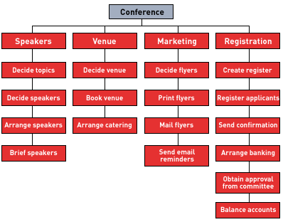
Risk Management Overview
Risk Techniques
Risk Breakdown
Structure

Slide 102
Risk Management Overview
Risk Techniques
Probability Impact Grid
Provides a way of prioritising risks
Provides a way of defining Risk Tolerance thresholds for a particular organisational activity
Used in the Assess – Estimate step, but defined (in terms of the scales and rankings to be used) in the Identify – Context step

Slide 103
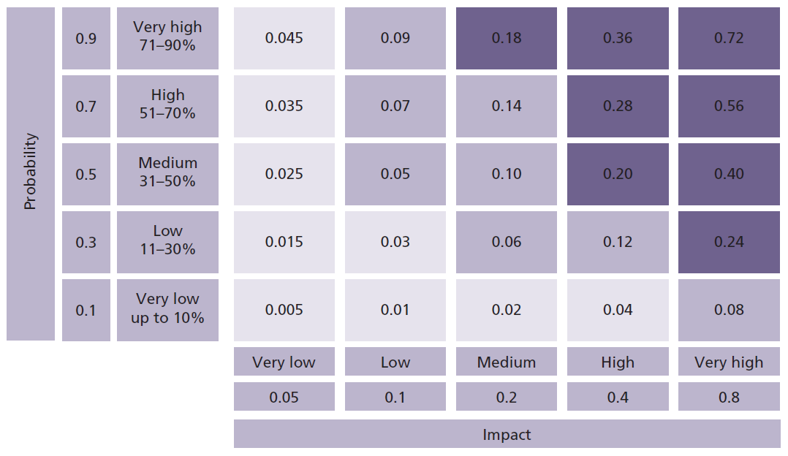
Risk Management Overview
Risk Techniques
Probability Impact Grid

Slide 104
Risk Management Overview
Risk Techniques
Summary Risk Profile
Provides a visualisation of the total risk posed to an organisational activity by positioning individual risks on a map
Shows the combined Probability and Impact Assessment
Incorporate Risk Tolerance threshold, providing the trigger for escalation
Uses colour-coding to reflect individual risk status
Must be kept current, and in line with the Risk Register

Slide 105
Risk Management Overview
Risk Techniques
Summary Risk Profile

Slide 106
Risk Management Overview
Risk Techniques
Summary Risk Profile
Risks outside of the Risk Tolerate threshold for the activity must be escalated
Colour-Code
White (agreed action cannot begin until a future date)
Red (no progress made)
Amber (moderate progress is being made but behind schedule)
Green (progress made in line with expectation for this stage of the activity)
Blue (risk response has been successfully implemented)

Slide 107
Risk Management Overview
Risk Techniques
Risk Response Planning
Enables a range of response options to be considered from a documented list
A response should be chosen that provides the maximum possible change to the risk exposure for the least investment
Response plans are recorded in the Risk Register
Important to document any residual risk remaining after the implementation of the chosen response
Important to identify and describe any secondary risks that may be caused by the implementation of the chosen response

Slide 108
Risk Management Overview
Risk Techniques
Risk Response Planning
Response Types
Avoid a Threat / Exploit an Opportunity
Reduce a Threat / Enhance an Opportunity
Transfer the Risk
Share the Risk
Accept the Risk
Prepare Contingency Plans

Slide 109
Risk Management Overview
Risk Techniques
Risk Response Planning
Response Types - Avoid a Threat / Exploit an Opportunity
This option is about making the uncertain situation certain by removing the risk, often by removing the cause of the threat or implementing the cause of the opportunity
In most cases, costs will be incurred in removing the risk the completely, these costs must be therefore be justified

Slide 110
Risk Management Overview
Risk Techniques
Risk Response Planning
Response Types – Reduce a Threat / Enhance an Opportunity
This option is about taking action now to
change the probability and/or impact of a threat (mitigation) or
Increase the likelihood and/or impact of an opportunity
In most cases, costs will be incurred when taking such actions. These costs must therefore be justified against the expected change to the residual risk

Slide 111
Risk Management Overview
Risk Techniques
Risk Response Planning
Response Types – Transfer a Risk
This option is about transferring part of the risk to a third-party (taking out an insurance policy is an example of this)
Used mainly as a response to Threats rather than Opportunities
Important to understand that only part of the risk is being transferred (e.g. an insurance policy would cover the cost should the threat actually occur, but the organisation would still be impacted in other areas such as time delay)
In most cases, costs will be incurred when taking such actions. These costs must therefore be justified against the expected change to the residual risk

Slide 112
Risk Management Overview
Risk Techniques
Risk Response Planning
Response Types – Accept the Risk
This option means that the organisation decides to accept that a risk may occur, and decides to take no action, exposing itself to the full possible impact
Residual risk is unchanged, but neither are any costs incurred
An organisation may take such an option with respect to the fluctuation of exchange rates, import duties or other such levies
This option should not be chosen if the risk expose exceeded the Risk Tolerance for the organisational activity in question

Slide 113
Risk Management Overview
Risk Techniques
Risk Response Planning
Response Types – Prepare Contingency Plans
This option means that the organisation decides to accept that a risk may occur, and decides to take no immediate action, but puts in place a series of contingencies to deal with the impact should it occur
Sometimes called the ‘fall-back plan’ option as it can be used as a secondary response when the response chosen initially has not resulted in the desired outcome

Slide 114
Risk Management Overview
Risk Health Check

Slide 115
Risk Management Overview
Risk Health Check
Used to check the health of current Risk Management practices and identify areas for improvement
Can be a self-assessment, performed internally, or carried-out by a specialist third-party (e.g. auditors)
Can be targeted at specific organisational activities and adapted to the nature of the business
Should be formally administered and follow a four step process of:
Preparation, Data Collection, Data Analysis, Review & Report

Slide 116
Risk Management Overview
Risk Health Check
Preparation
Confirm sponsor
Define scope and timing of the exercise
Select a team and brief them on any relevant background information
Define roles and responsibilities
Agree the approach and the questions that will be asked
Define the interview format and schedule the interviews

Slide 117
Risk Management Overview
Risk Health Check
Data Collection
Review available documentation and record individual findings
Carry-out interviews and record in detail
Data Analysis
Identify and patterns and trends
Identify strengths and weaknesses
Focus on key items that need to be addressed
Conduct intermediate interview with the sponsor
Identify recommendations

Slide 118
Risk Management Overview
Risk Health Check
Review and Report
Draft report
Conduct final interview with sponsor
Finalise and submit report

Slide 119
Risk Management Overview
Risk Health Check
Questions to be asked
Should be structured into 8 sections, on for each of the Risk Management Principals
Questions can be quite detailed, but should solicit a simply ‘yes’ or ‘no’ answer in order to make analysis possible.
Alternative scoring methods can be used (e.g. 1 to 5, or Poor/Average/Good)
Questions should be asked and answered in an honest, open, and blame-free environment in order to capture the most realistic overall picture

Slide 120
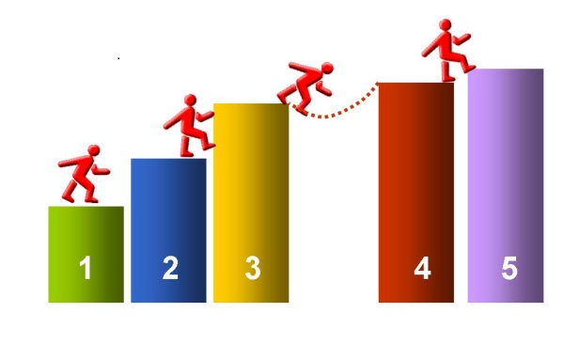
Risk Management Overview
Risk Maturity Model

Slide 121
Risk Management Overview
Risk Maturity Model
Establishes a benchmark for moving forward
Provides the basis for an organisation to measurement the level to which Risk Management has been successfully embedded against a globally used and accepted model (CMM)
Forms the platform for continual incremental improvement over time

Slide 122
Risk Management Overview
Risk Maturity Model
Usual structure of the model is as a matrix with the following three components
Levels
Criteria
Competency
It is common to use the 8 Risk Management Principals as the Criteria

Slide 123
Risk Management Overview
Risk Maturity Model
Sample matrix before organisational specific competencies are added

Slide 124
Risk Management Overview
Risk Maturity Model
5 Levels of Maturity
Initial
Repeatable
Defined
Managed
Optimising

Slide 125
Risk Management Overview
Risk Maturity Model
1st Level of Maturity – Initial
The organisation undertakes the minimum risk identification and assessment required to satisfy compliance requirements
Risks are examined only annually
No definition in place for Risk Tolerance or Risk Appetite
No formal risk process in place
Risks that occur are dealt with only in a reactive manner

Slide 126
Risk Management Overview
Risk Maturity Model
2nd Level of Maturity – Repeatable
Risk Tolerance and Risk Appetite have been establish
A risk process has been defined
A risk profile is in place, providing understanding of the sources of risk that the organisation faces
The organisation has started to allocate resources to risk-related activities
Roles and responsibilities are starting to be formally defined

Slide 127
Risk Management Overview
Risk Maturity Model
3rd Level of Maturity – Defined
Processes have been further developed and refined
A dedicated risk management function has been created, co-ordinating effort and ensuring a consistent approach
Early Warning Indicators are developed
Response Planning is starting to take shape
High-level risks are reviewed on a regular basis at board level

Slide 128
Risk Management Overview
Risk Maturity Model
4th Level of Maturity – Managed
The culture of Risk Management is being led by the CEO
Risk Management plays a regular part in key decision-making
Analysis of risk has become more rigorous, leading to improvement in response planning and implementation
There is an stronger emphasis on measuring, aggregating and managing risks across the whole organisation
A dedicated budget for managing risk has been established

Slide 129
Risk Management Overview
Risk Maturity Model
5th Level of Maturity – Optimising
The highest level of maturity
There is now a culture of continual improvement filtered down into all layers of the organisation
Risk Management policies, processes and resources are fully aligned
A training and education programme is in place
Risk Management responsibilities are included in Job Descriptions, Staff Inductions and Staff Appraisals

